Slide 1

SOFTWARE TESTING
UE18CS400SB
Prof. Venkatesh Prasad
venkateshprasad@pes.edu
Department of Computer Science

Slide 2

SOFTWARE TESTING
Acceptance Testing
Prof. Venkatesh Prasad
Department of Computer Science and Engineering

Slide 3
SOFTWARE TESTING
Acceptance Testing
Testing done in accordance with customer specified criteria
Typically Criteria is pre-defined and mutually agreed.
Typically done under the customer controlled environment by customer designated individuals

Slide 4
Client
End users
SOFTWARE TESTING
Who Performs AT?

Slide 5
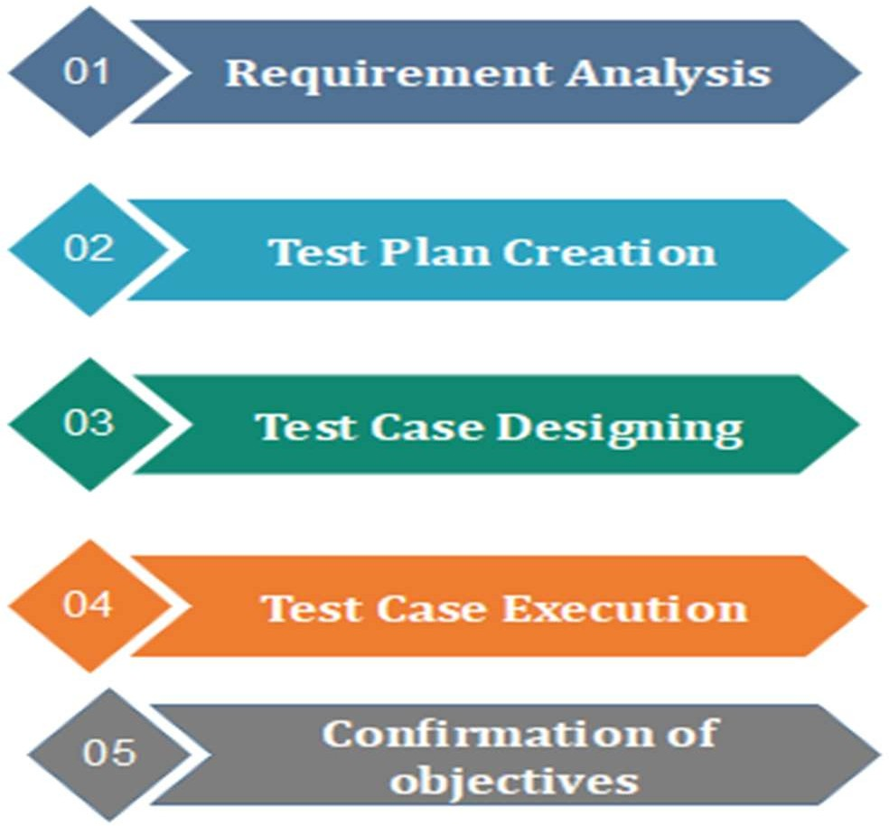
SOFTWARE TESTING
How to do AT Testing?

Slide 6
SOFTWARE TESTING
Types
User Acceptance Testing (UAT)
Business Acceptance Testing (BAT)
Contract Acceptance Testing (CAT)
Regulations Acceptance Testing (RAT)
Operational Acceptance Testing (OAT)
Alpha Testing
Beta Testing

Slide 7
SOFTWARE TESTING
Acceptance Testing Approaches
Design / Architecture based approach
Full functionality
Cases that fail here may trigger review of previous phases & improvise
Business vertical / customized instance
Typically for products / frameworks
Customized instances are put through testing based on business domain
Deployment focused
Large applications need to be tested in complex environments of hardware / software scenarios

Slide 8
SOFTWARE TESTING
Acceptance Testing Criteria
▪ Typically involves specifying
business
at source during each month salary
functionality of some
complexity
▪ Ex. Should do tax deduction disbursement
Most of the high priority requirements are covered in the criteria.
Legal & Statutory requirements
May cover some non-functional requirements also
▪ Should process 100 million call records in 2 hours!

Slide 9
SOFTWARE TESTING
Acceptance Testing Criteria
Criteria could also be process / procedure requirements
Test reports should show a coverage of > 85% at component level
80 staff members trained in using the data entry
All help documents must open in “Star Office”
In service contracts, it takes the form of SLA – Service Level Agreement
Defects must be fixed in 25 business hours

Slide 10
SOFTWARE TESTING
Acceptance Testing – Test Cases
Typical Test cases cover
Critical functionality
Most used functionality
End-to-end scenarios
New functionalities – during upgrade
Legal / statutory needs
Functionality to work on a defined corpus of data.

Slide 11
SOFTWARE TESTING
Acceptance Testing Execution
Typically happens “On-Site” after careful environment setting
There should be ‘stand-by’ dev team to address blocking issues
Needs a team with very good business functional knowledge and application working knowledge
▪ Major defects – also defined as part of criteria acceptance test
▪ Has to be re-started after the defect is addressed
– break the
▪ Careful execution documentation is a must with final reporting.

Slide 12
▪ Customers are wary of providing acceptance criteria
SOFTWARE TESTING
Acceptance Testing Challenges
▪ Not easy to specify – Needs good effort.
Most of the times vendor company defines the criteria and gets concurrence
▪ Development team might omit what is not in the Acceptance Test
Multiple iterations may be required and multiple customer representatives may be involved
Results need to be carefully analyzed.

Slide 13

THANK YOU
Prof. Venkatesh Prasad
venkateshprasad@pes.edu
Department of Computer Science

